Slide 1
Advanced Neural Networks
Dr Chathura Rajapakse

Slide 2
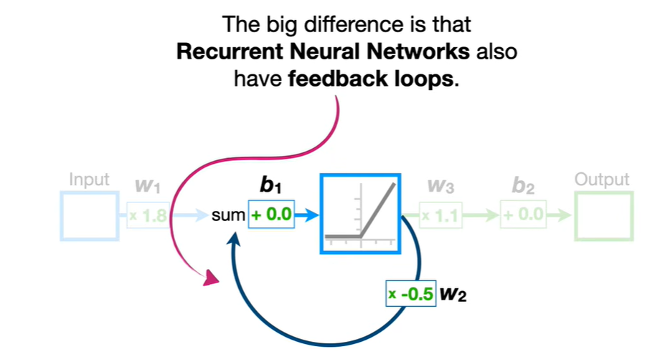
Recurrent Neural Network

Slide 3
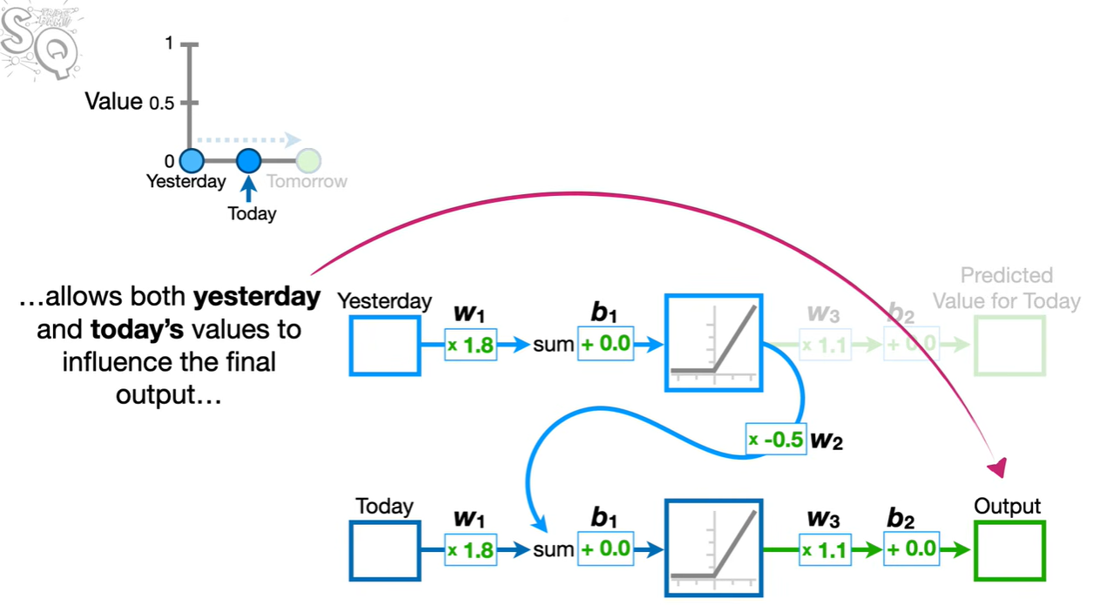
Recurrent Neural Network

Slide 4
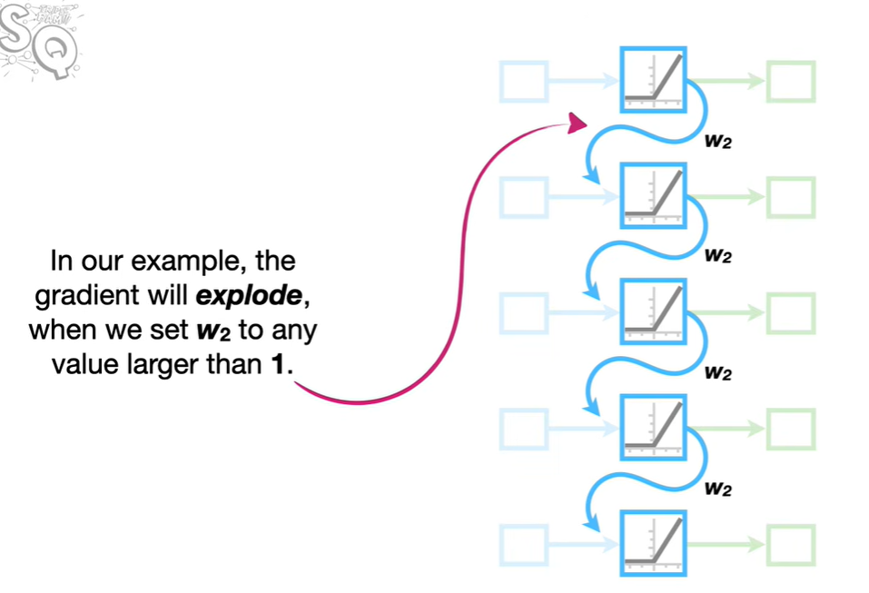
Vanishing/Exploding Gradient

Slide 5
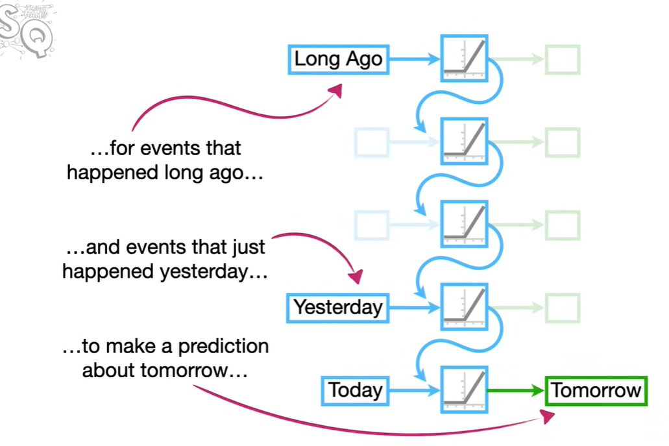
Towards LSTM

Slide 6
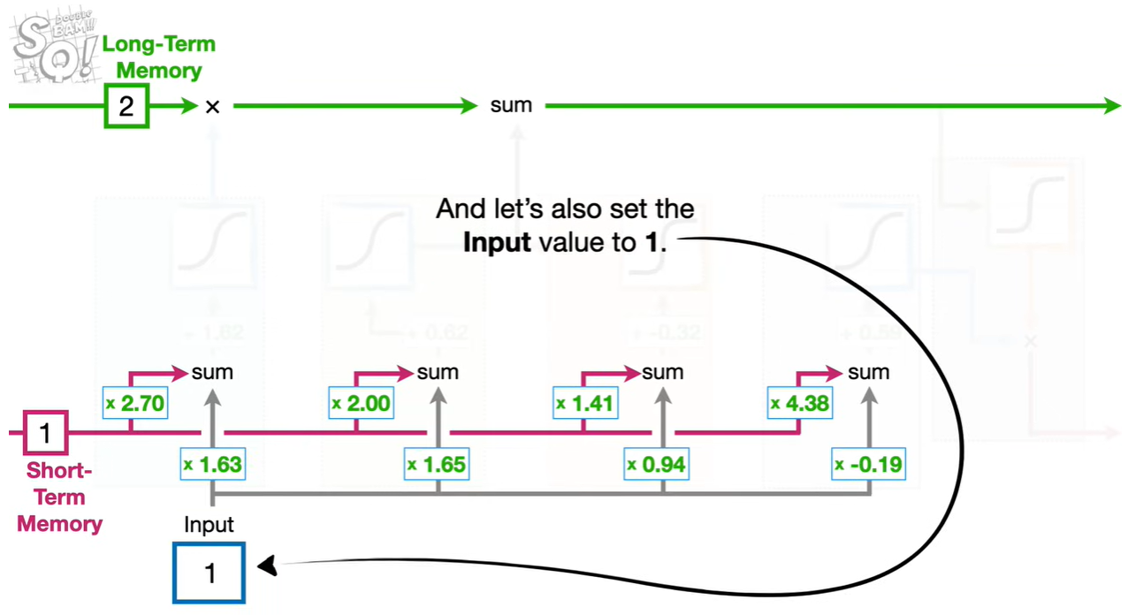
LSTM Basics

Slide 7
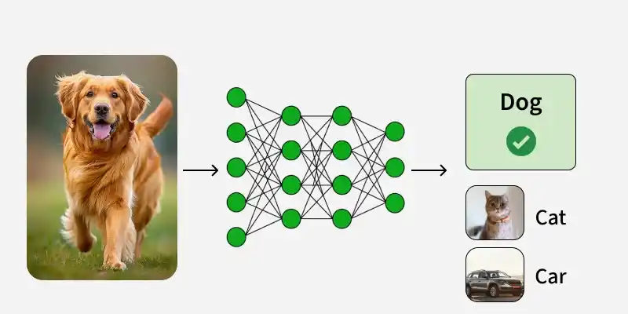
Computers see the world
Image recognition (classification)

Slide 8
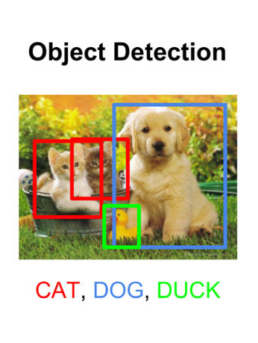
Object Detection
Like image classification, object detection attempts to predict the contents of an image, but now with multiple objects, not just a single one
The models are trained to predict the “Bounding Boxes” of objects in the image, and apply labels for the contents of each box

Slide 9
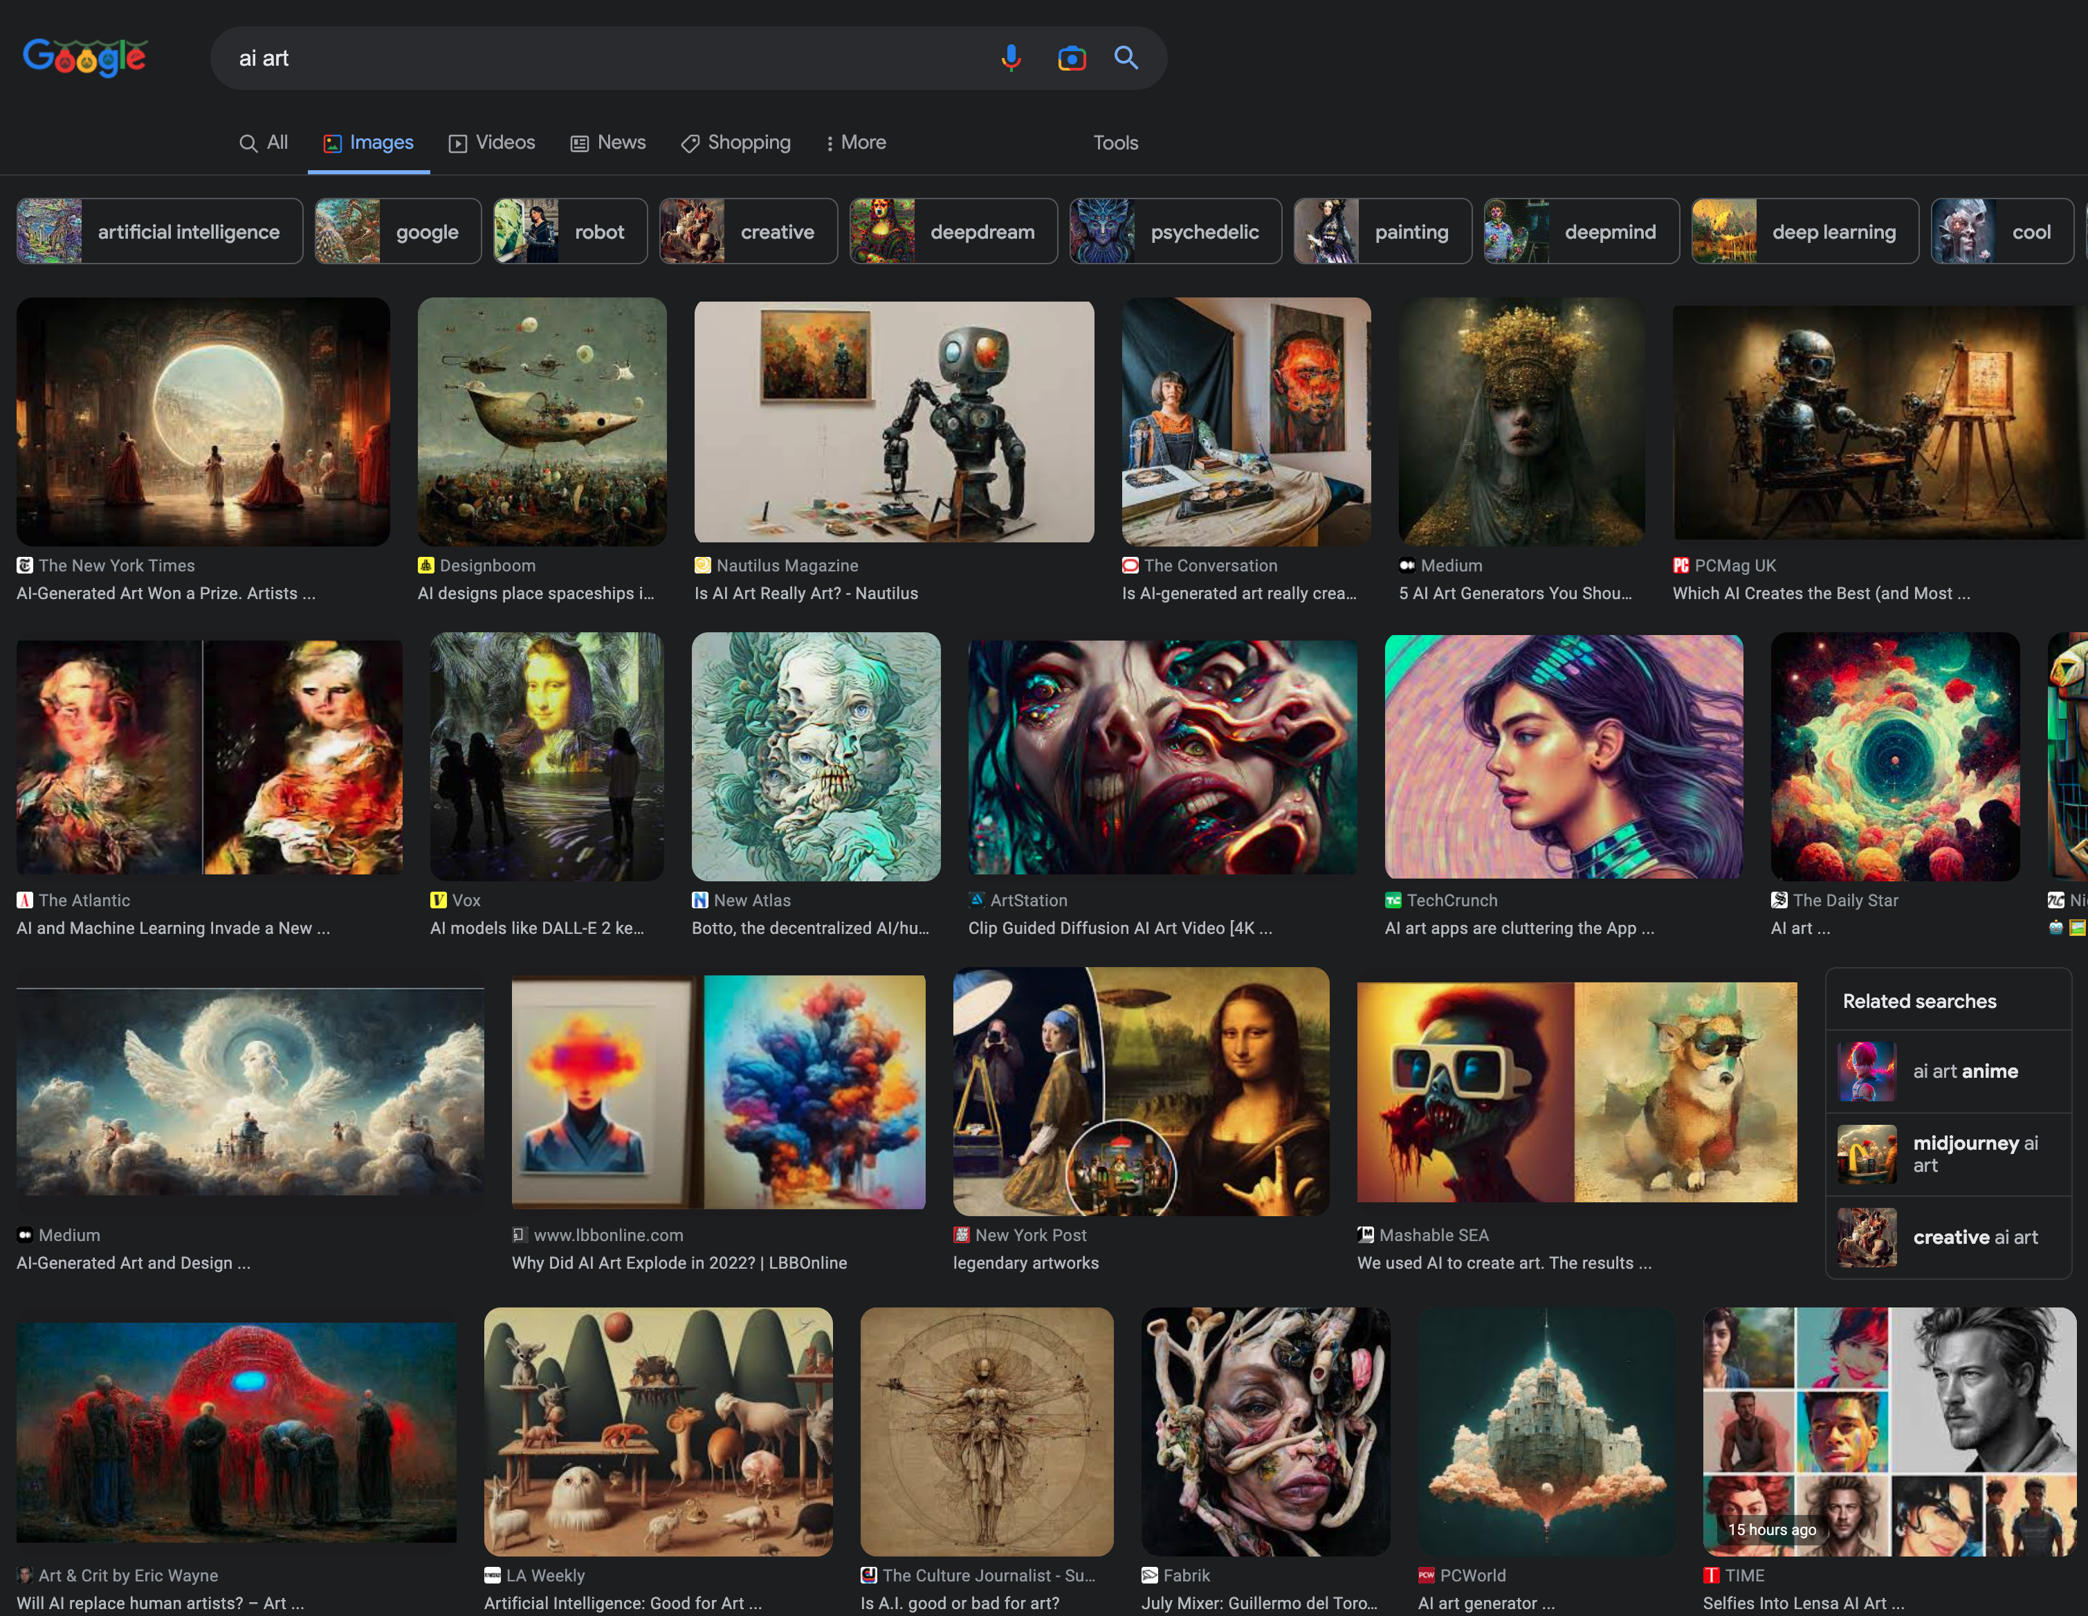
Image Generation
Increasingly popular in the last few years, training models to create images, either from scratch or with a prompt, has many applications.
Raise of Stable Diffusion has lead to an explosion of “AI Art”, but other models include VAEs and Generalised Adversarial Nets (GANs)
Can be used for image restoration and scene reconstruction.

Slide 10
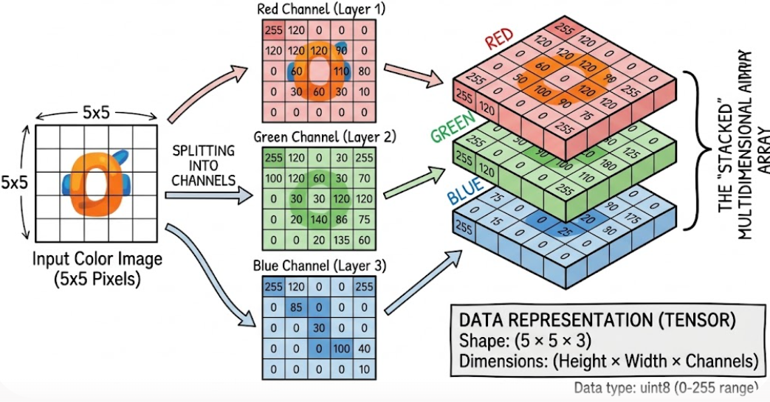
How do we set the features of an image?
Notes:
Ask students for examples of computer vision techniques that they use in their lives

Slide 11
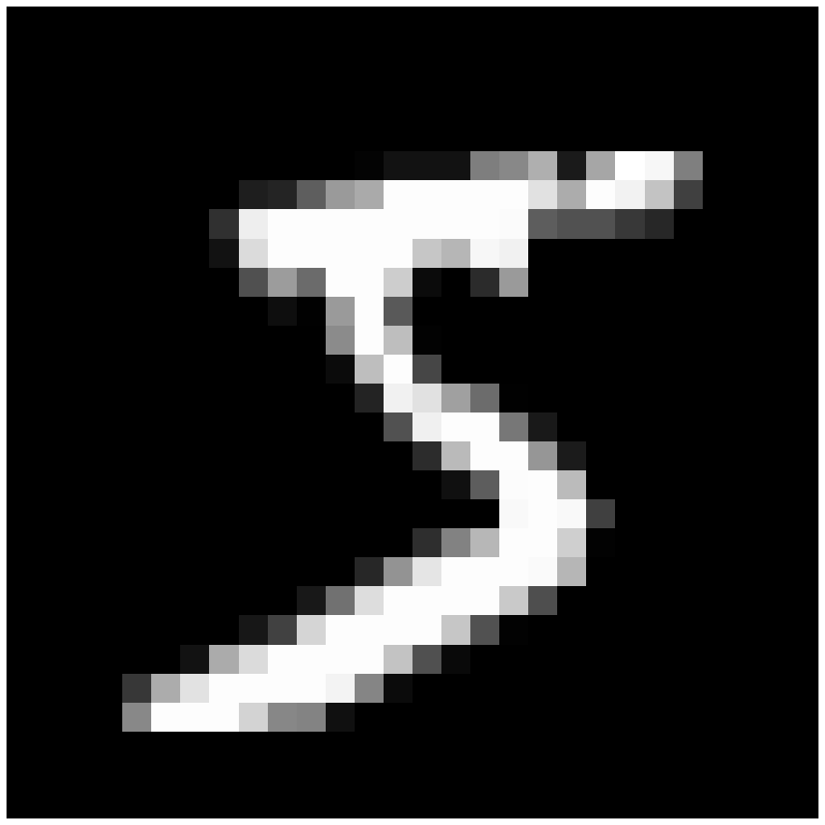

What do computers see?

Slide 12
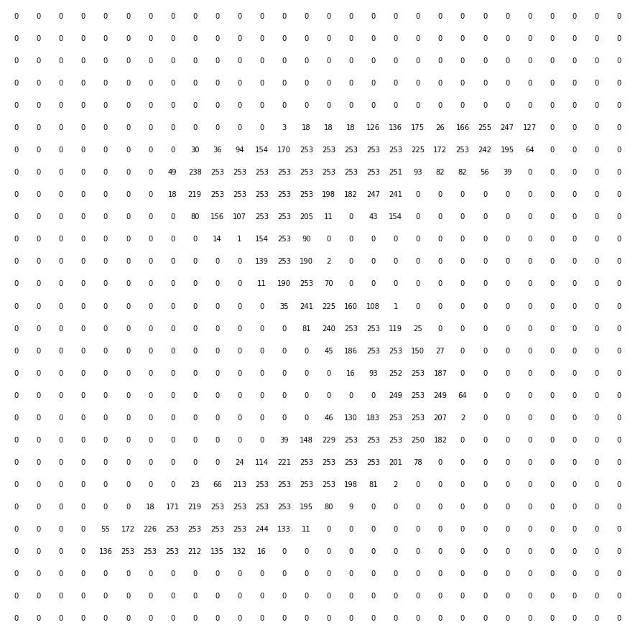
What do computers see?

Slide 13
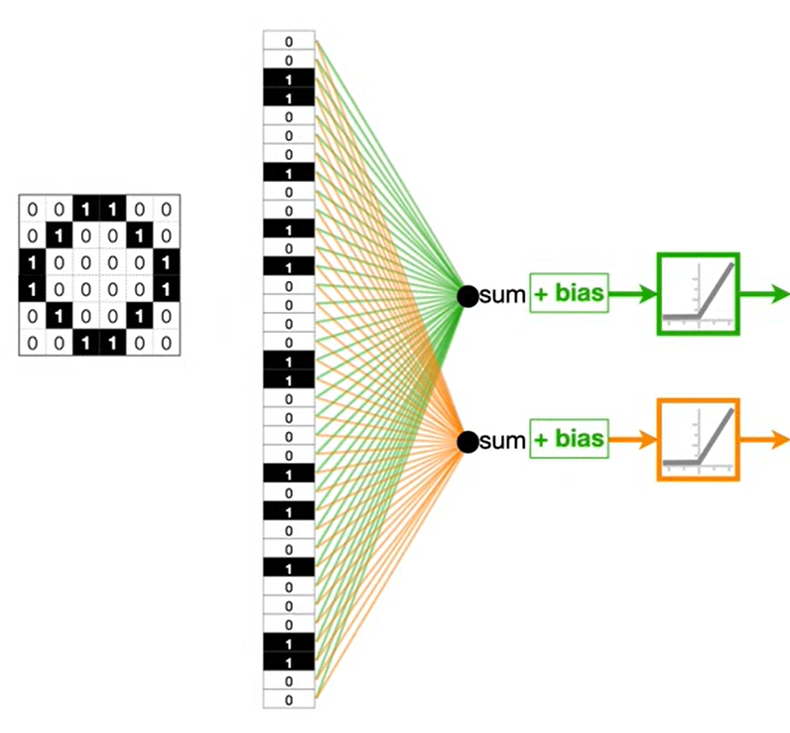
Why standard NNs fail on images
Destroys Spatial Geometry: Pixel neighborhood relationships are lost during 1D unrolling.
Parameter Explosion: High-resolution inputs create millions of dense weight connections.
No Shift Invariance: Small shifts in object location break model recognition.

Slide 14
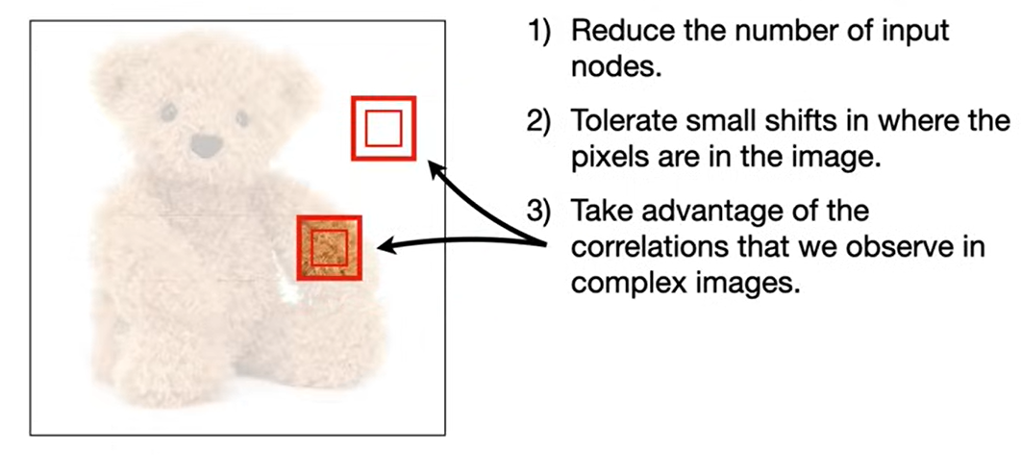
What CNNs does

Slide 15
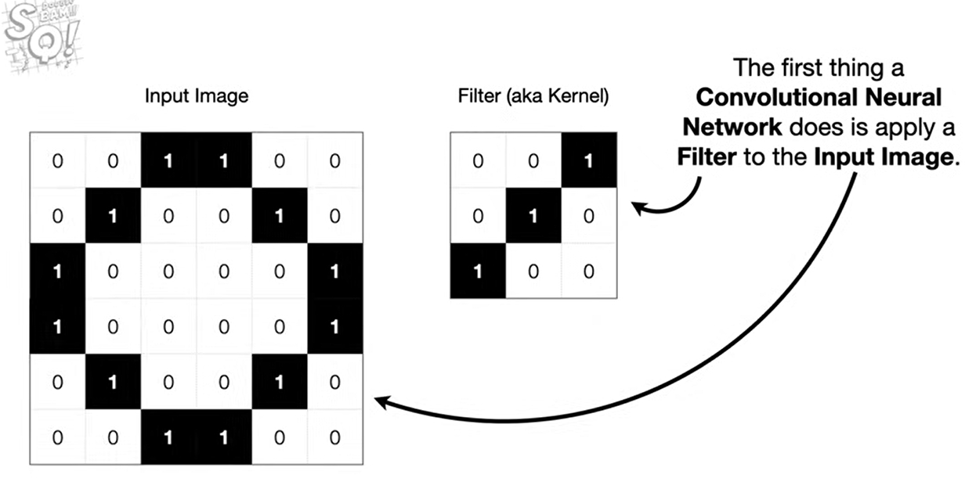
CNN – Step 01

Slide 16
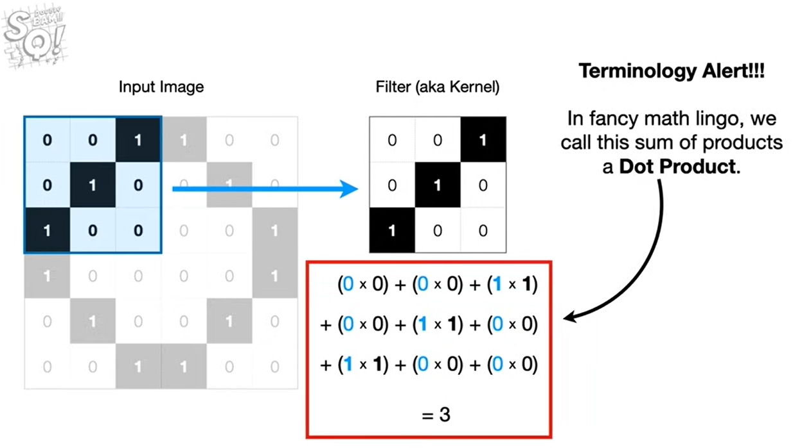
CNN – Step 02

Slide 17
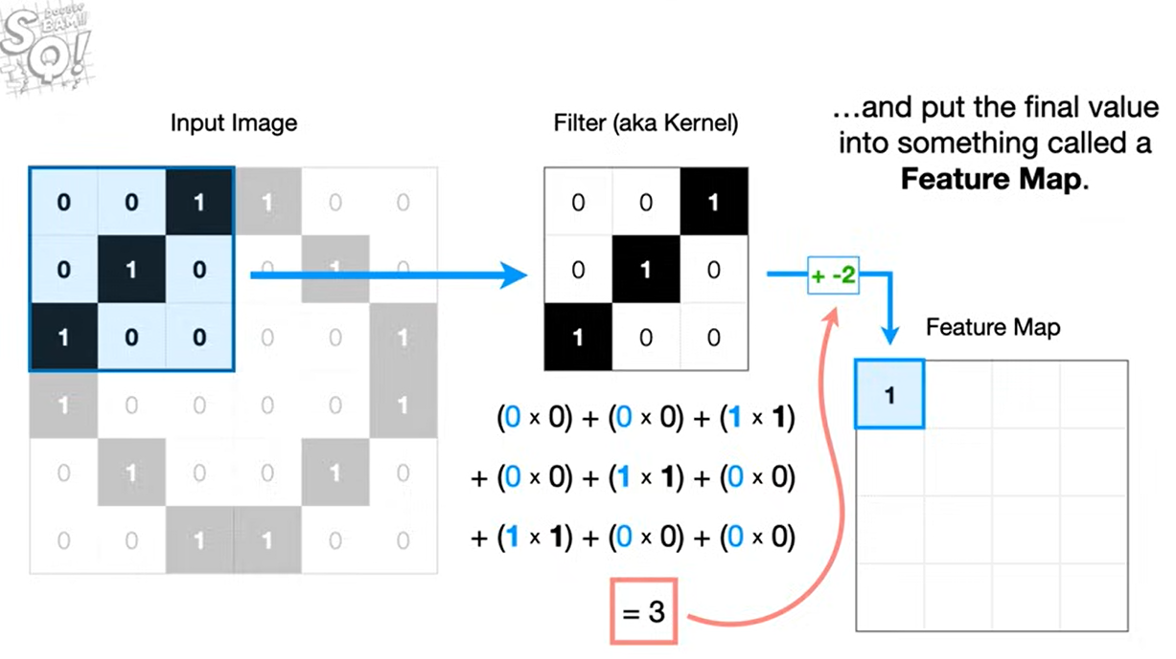
CNN – Step 03

Slide 18
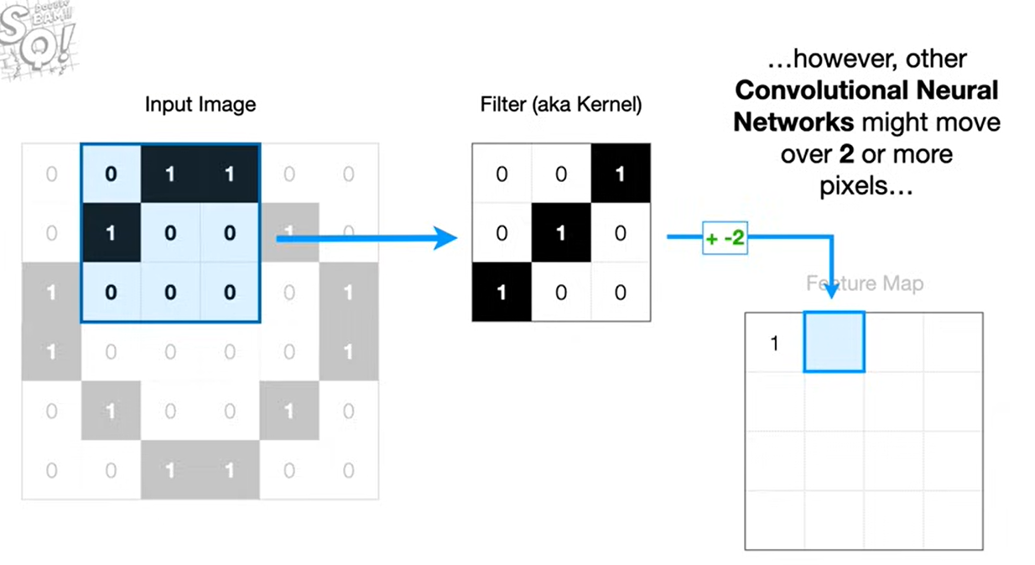
CNN – Step 04

Slide 19
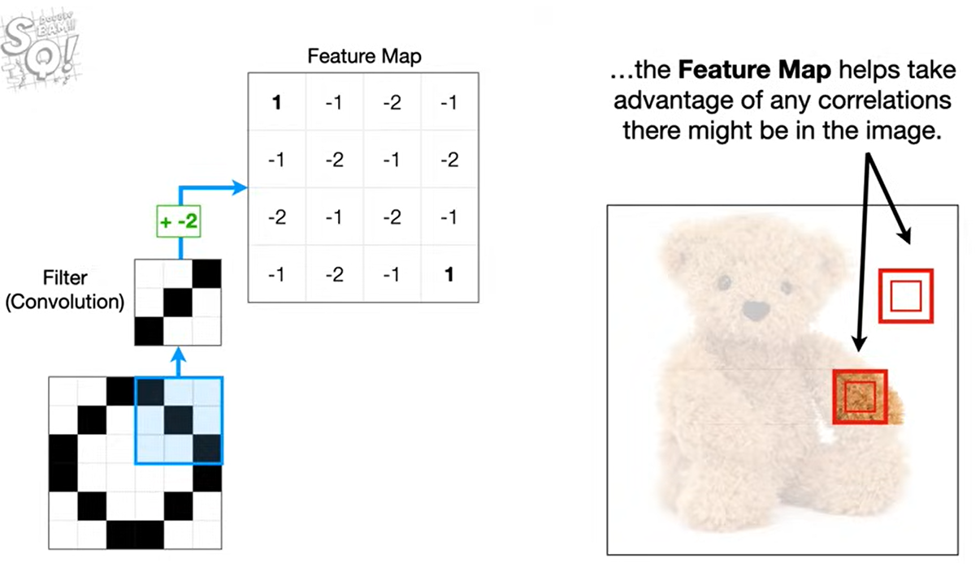
Why Feature Map

Slide 20
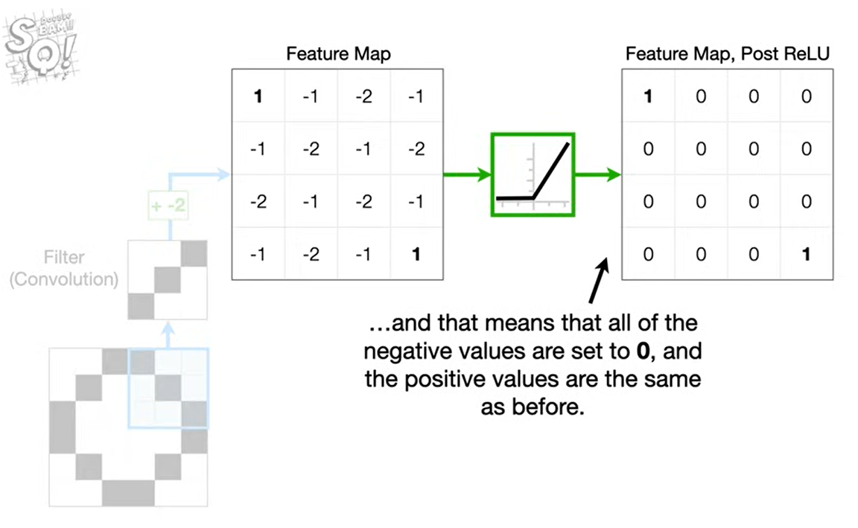
CNN – Step 05

Slide 21
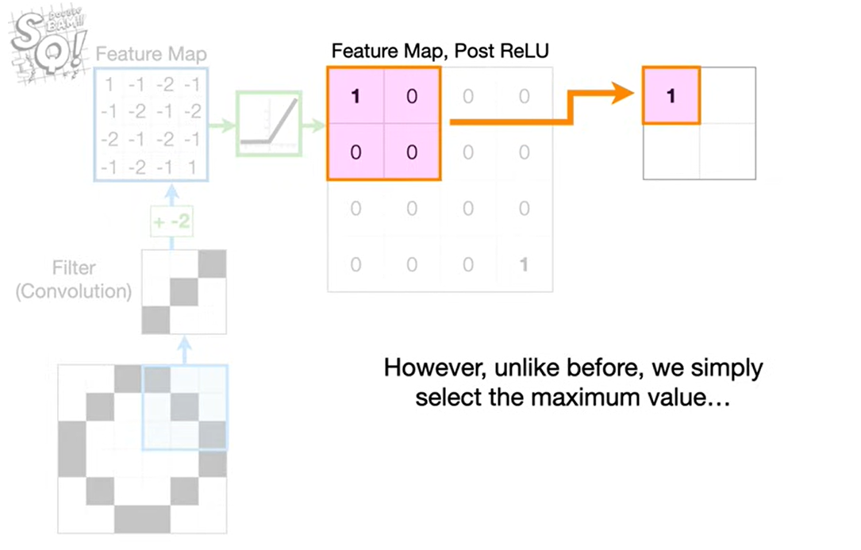
CNN – Step 06

Slide 22
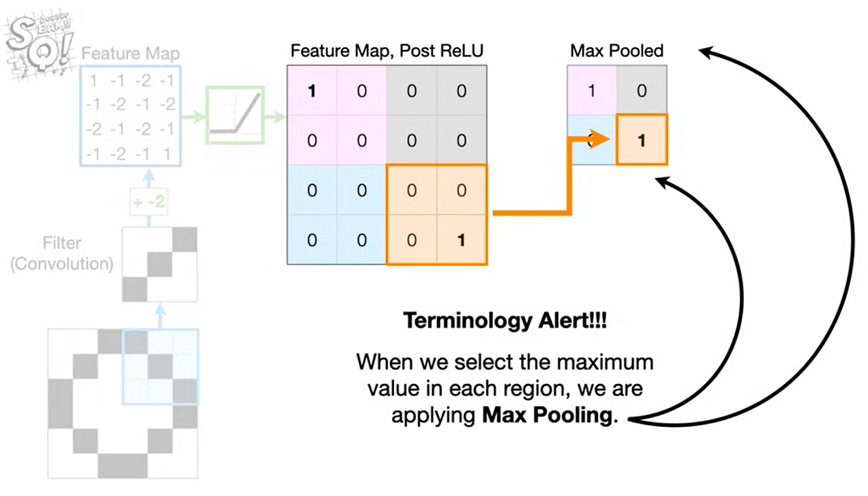
Max pooling

Slide 23
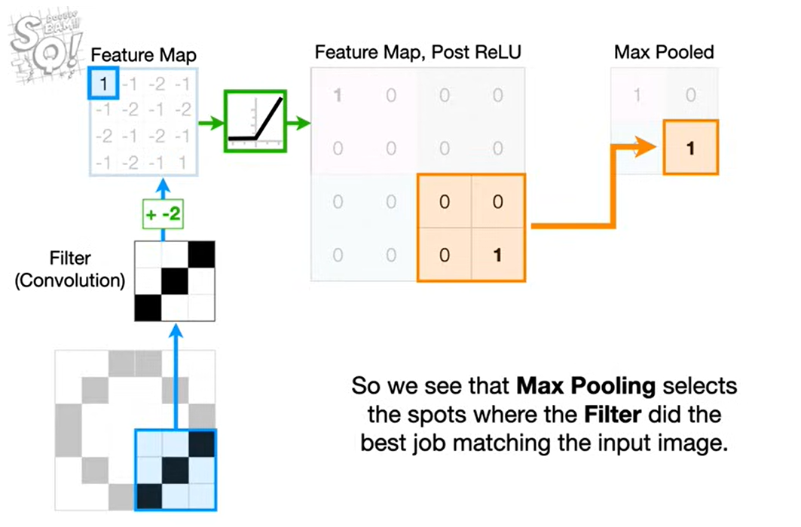
Max pooling

Slide 24
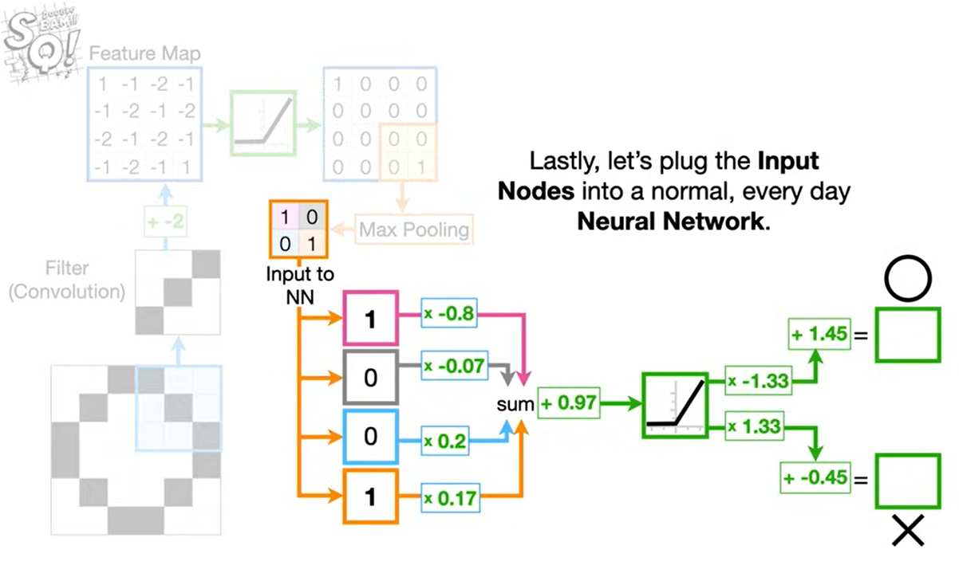
CNN – Step 07

Slide 25
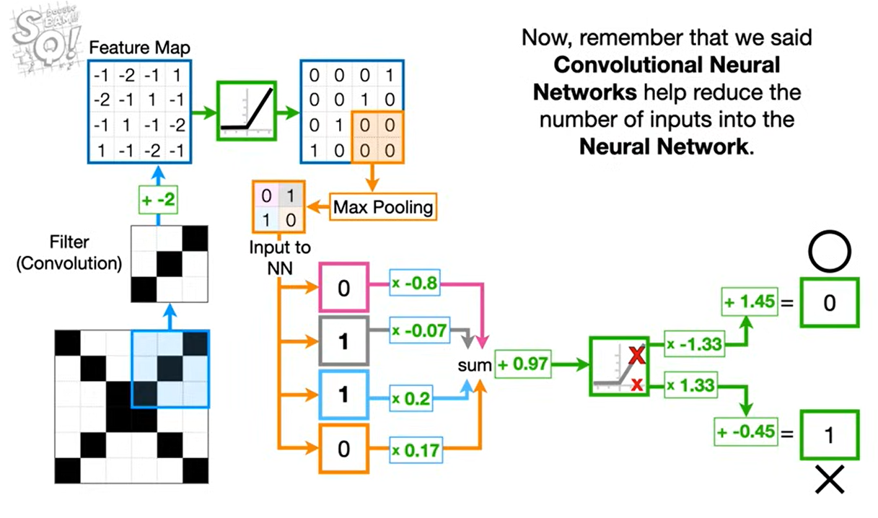
CNN – Step 08

Slide 26
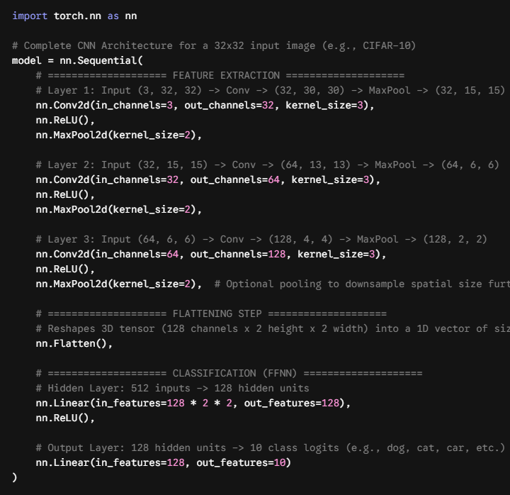
CNN Code
Interpret this

Slide 27
Assignment 02
For this assignment, you will build and train a PyTorch U-Net autoencoder on Google Colab to automatically colorize grayscale images using the Lab color space. Your task is to implement a data pipeline that resizes images to $128 \times 128$ pixels, converts them from RGB to Lab space, passes the single-channel L (lightness) as input, and trains the network to predict the two-channel $a$ and $b$ color components using Mean Squared Error ($\text{MSE}$) loss. Once your model is trained for 15–20 epochs, you will apply it to a personal historical black-and-white photograph (such as one of your grandparents) by extracting its L channel, predicting its missing a and b color channels, and recombining all three back into a full RGB image. You will submit a single Notebook containing your dataset code, U-Net architecture, training metrics, and a final figure displaying the grayscale input, model prediction, and fully restored color image.

